Slide 1
C Functions

Slide 2
C++ Functions
A function is a group of statements that together perform a task. Every C program has at least one function, which is main(), and all the most trivial programs can define additional functions.
You can divide up your code into separate functions. How you divide up your code among different functions is up to you, but logically the division usually is so each function performs a specific task.

Slide 3
C++ Functions
A function declaration tells the compiler about a function's name, return type, and parameters. A function definition provides the actual body of the function.
The C Standard library provides numerous built-in functions that your program can call. For example, function strcat() to concatenate two strings, function memcpy() to copy one memory location to another location and many more functions.
A function is knows as with various names like a method or a sub-routine or a procedure etc.

Slide 4

Defining a Function
The general form of a C function definition is as follows:

Slide 5
Defining a Function:
A C function definition consists of a function header and a function body. Here are all the parts of a function:
Return Type: A function may return a value. The return_type is the data type of the value the function returns. Some functions perform the desired operations without returning a value. In this case, the return_type is the keyword void.
Function Name: This is the actual name of the function. The function name and the parameter list together constitute the function signature.
Parameters: A parameter is like a placeholder. When a function is invoked, you pass a value to the parameter. This value is referred to as actual parameter or argument. The parameter list refers to the type, order, and number of the parameters of a function. Parameters are optional; that is, a function may contain no parameters.
Function Body: The function body contains a collection of statements that define what the function does.

Slide 6
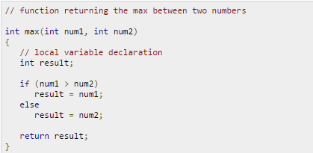
Example:
Following is the source code for a function called max(). This function takes two parameters num1 and num2 and returns the maximum between the two:

Slide 7
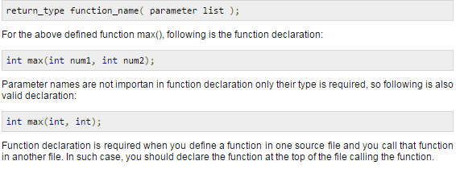
Function Declarations:
A function declaration tells the compiler about a function name and how to call the function. The actual body of the function can be defined separately.
A function declaration has the following parts:

Slide 8
Calling a Function:
While creating a C function, you give a definition of what the function has to do. To use a function, you will have to call or invoke that function.
When a program calls a function, program control is transferred to the called function. A called function performs defined task and when its return statement is executed or when its function-ending closing brace is reached, it returns program control back to the main program.
To call a function, you simply need to pass the required parameters along with function name, and if function returns a value, then you can store returned value. For example:

Slide 9
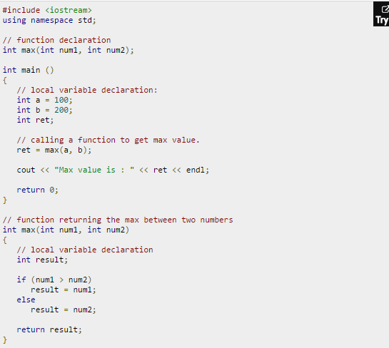

Slide 10
Result:
I kept max() function along with main() function and compiled the source code. While running final executable, it would produce the following result:
Max value is : 200

